Slide 1

Travel Insurance
Ivie Irivbogbe
BANA 7365 Final Project
April 15, 2024

Slide 2
Travel Insurance Dataset - Binary Classification Analysis
Sources
https://www.kaggle.com/datasets/mhdzahier/travel-insurance?select=travel+insurance.csv
Summary
This dataset originates from a Singapore-based third-party travel insurance servicing company and encompasses travel insurance policy records.
The primary objective of this data is to predict the 'Claim Status’, a binary outcome indicating whether a claim was made ('Yes') or not ('No’).
Key Attributes
Claim Status (Target): The binary outcome of whether a claim was filed.
Agency: The name of the travel insurance agency.
Agency Type: Categorization of the agency, e.g., Airlines or Travel Agency.
Distribution Channel: The channel through which the insurance was sold, e.g., Online or Offline.
Product Name: Specific insurance product purchased.
Duration: Period of the insurance coverage.
Destination: Travel destination covered by the insurance.
Net Sales: Revenue from the sale of the travel insurance policy.
Commission: Earnings received by the agency for the policy sale.
Gender: Gender of the insured party.
Age: Age of the insured party.

Slide 3
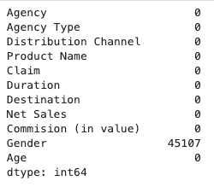
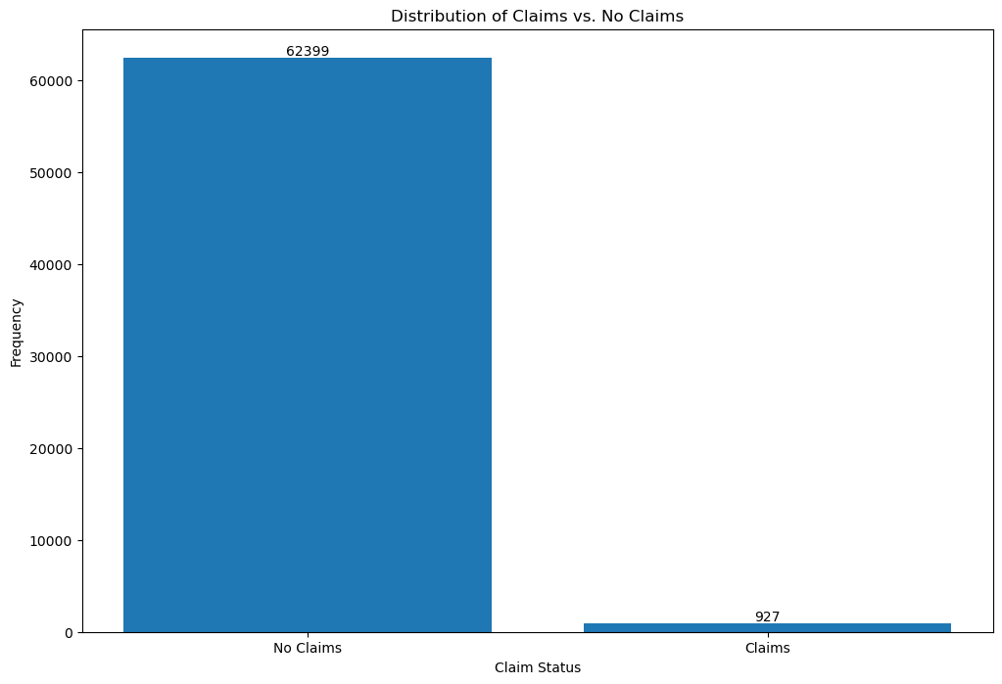
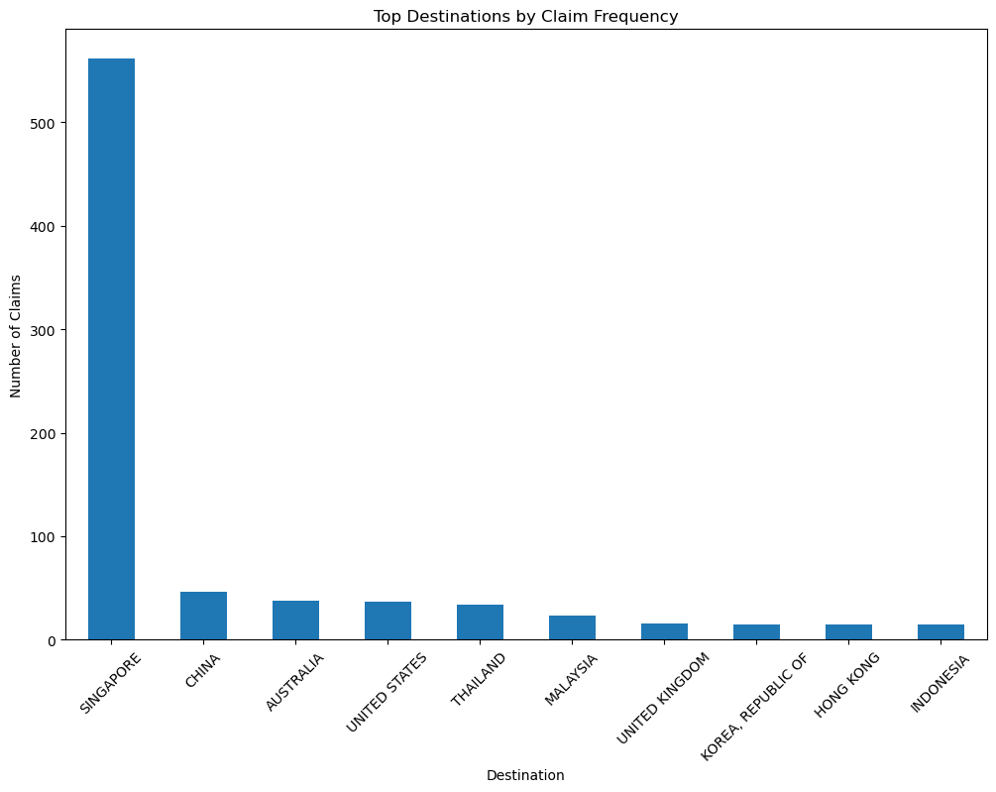
Dataset Attributes
The Gender column had about 45,000 missing values
The dataset had both numerical and categorical variables
There is a significant imbalance between 'No Claims' vastly outnumbering 'Claims’.
Singapore has more claims than other locations, such as China, Australia, and the United States.

Slide 4
The Baseline Model – Logistic Regression
Baseline Model: Logistic Regression with liblinear solver - Based on the Train Set.
Performance Without Class Weight:
Accuracy: 98.53%
Precision: 0.0, Recall: 0.0, F1 Score: 0.0, ROC AUC Score: 0.5
Observations: High accuracy is overshadowed by zero precision, recall, and F1, suggesting the model mainly predicts the majority class(No Claims). ROC AUC suggests no better than random guessing for minority class(Claims)
Performance With Class Weight:
Accuracy: 79.74%
Precision: 5.23%
Recall: 74.43%
F1 Score: 9.78%
ROC AUC: 77.13%
Insights: The model with class weight adjustment indicates a more balanced performance, successfully identifying more instances of the minority class. The ROC AUC score suggests moderate discriminative ability, with potential for improvement.
Next Steps: Implement tree-based models(Random Forest and Gradient Boosting) for enhanced balance and predictive power.

Slide 5
Methodology
Data Integrity: Missing entries imputed to ensure comprehensive analysis.
Dataset Split: 80% training set for model building and 20% testing set for performance validation.
Dataset Preparation: Features one-hot encoded to transform categorical variables for model compatibility.
Model Training: Trained models to identify patterns indicative of claims.
Cross-Validation: Applied five-fold cross-validation for robust model evaluation.
Precision Tuning: Parameters fine-tuned to maximize prediction accuracy.
Diverse Predictive Models: Employed Logistic Regression, Random Forest, and XGBoost for varied insights.
Class Weight Adjustment: Implemented class weight adjustments to balance the influence of all classes.

Slide 6
Best Model - XGBoost Model
XGBoost Model on Train Set
Optimized via grid search in 121.17 seconds.
The best parameters are learning rate - 0.3, max depth - 20, and 400 estimators.
Model Training Performance
Accuracy: 99.72% — indicative of high overall correctness.
Precision: 84.03% — the majority of positive predictions were correct.
Recall: 100% — perfectly identified all positive instances.
F1 Score: 91.33% — an excellent balance between precision and recall.
ROC AUC: 99.86% — superior ability to differentiate classes.
Model Robustness
Demonstrates reliability and accuracy in identifying and classifying outcomes.
Ensures confidence in the model's applicability for practical use cases.
Next Step: Validate on a separate test set to confirm model generalizability.

Slide 7
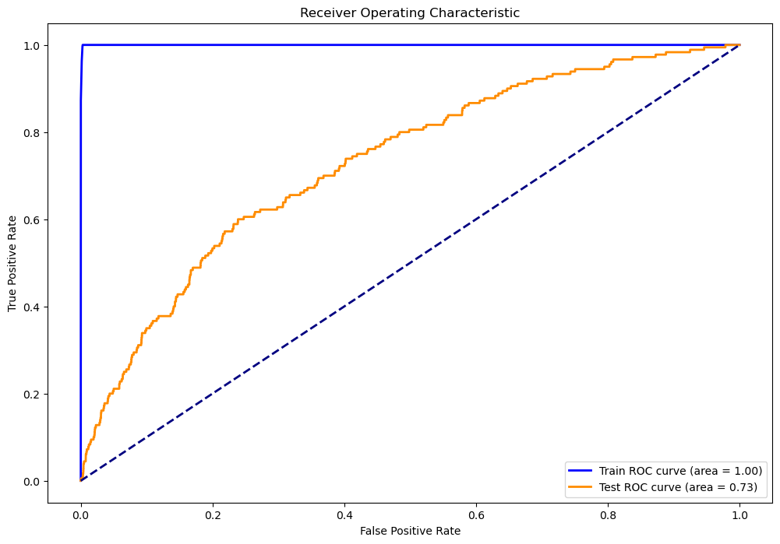
Final Evaluation
XGBoost Model on Test Set
Grid search optimized: 125.87 seconds elapsed.
The best parameters are learning rate - 0.3, max depth - 20, and 400 estimators.
Performance Metrics
Accuracy: 97.42% — reflects a high correct classification rate.
Precision: 8.47% — low rate of correct positive predictions.
Recall: 8.33% — minimal coverage of actual positive cases.
F1 Score: 8.40% — Indicates imbalance in precision and recall.
ROC AUC: 53.52% — suggests a slight ability to distinguish classes.
Observations
The model struggles with class imbalance despite high accuracy, as indicated by low precision, recall, and F1 score. A substantial discrepancy between training and testing performance may signal overfitting.

Slide 8
THANK YOU

